Slide 1
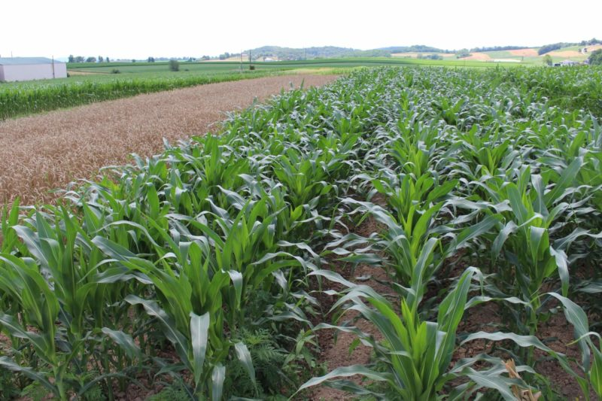
Crop Detection Website
Submitted By :
Abhinav Choudhary 2100290140002
(team leader)
Akshit Sehrawat 2100290140019
Akshay Chaudhary 2100290140010
Supervisor:
Dr. Vidushi

Slide 2
INTRODUCTION
A major contribution to India's economy is made by Agriculture. A lot of families in India directly or indirectly depend on farming in general. Hence, we can say farming is an integral part of India and define who we are as a country.
A combination of machine learning algorithms, historical and scientifically collected soil parameters can help predict the most appropriate crop to be sown on the farm.
Here, we propose a web application that allows users to get instant guidance on their better crop production through an intelligent system online.
The application is fed with various details and the associated with soil parameters and crop production.

Slide 3
INTRODUCTION
The application allows user to get the recommendation of crop.
It will provide better crop production as per the soil parameters.
Here we use some special Algorithms which analyses the details of the user and recommend which crop is better to be cultivated.
The system provide good crop production.

Slide 4


TECHNOLOGIES
ReactJS is a declarative, efficient, and flexible JavaScript library for building reusable UI components. It is an open-source, component-based front end library responsible only for the view layer of the application. It was created by Jordan Walke, who was a software engineer at Facebook. It was initially developed and maintained by Facebook and was later used in its products like WhatsApp & Instagram. Facebook developed ReactJS in 2011 in its newsfeed section, but it was released to the public in the month of May 2013.
A ReactJS application is made up of multiple components, each component responsible for outputting a small, reusable piece of HTML code. The components are the heart of all React applications.
Django is a Python framework that makes it easier to create web sites using Python.
Django takes care of the difficult stuff so that you can concentrate on building your web applications.
Django emphasizes reusability of components, also referred to as DRY (Don't Repeat Yourself), and comes with ready-to-use features like login system, database connection and CRUD operations (Create Read Update Delete).

Slide 5


TECHNOLOGIES
MySQL is a very popular open-source relational database management system (RDBMS).
MySQL is a fast, easy-to-use RDBMS being used for many small and big businesses.
MySQL is becoming so popular because of many good reasons −
MySQL is released under an open-source license. So you have nothing to pay to use it.
MySQL is a very powerful program in its own right. It handles a large subset of the functionality of the most expensive and powerful database packages.
MySQL uses a standard form of the well-known SQL data language.
MySQL works very quickly and works well even with large data sets.
MySQL is customizable. The open-source GPL license allows programmers to modify the MySQL software to fit their own specific environments.
Scikit-learn (Sklearn) is the most useful and robust library for machine learning in Python. It provides a selection of efficient tools for machine learning and statistical modeling including classification, regression, clustering and dimensionality reduction via a consistence interface in Python. This library, which is largely written in Python, is built upon NumPy, SciPy and Matplotlib.

Slide 6
BENEFITS
User can do farming with better crop health .
Users can view history of the recommendations for his analysis.
Precision farming is providing betterment in agriculture.

Slide 7
HARDWARE AND SOFTWARE USED :
Operating System: Window 10
Processor : Intel core™ i5-10210U CPU @ 1.60GHz 2.11 GHz
System Type : 64 bit
IDE : V.S Code , Pycharm.

Slide 8
MODULE
The system comprises of 2 major modules as follows:
Admin Module :
• Add Training Data
• View User Details
• View Feedback
• View Training Data

Slide 9
MODULE
USER MODULE
1. Recommend Crop (By providing Details like)
N
P
K
Humidity
PH
Rainfall
Temperature.

Slide 10
MODULE
USER MODULE
2. Give Feedback
3. History

Slide 11
OUTCOME
Created a Website Providing instant Crop Detection .
It will predict What kind of crop is benifitial to grow according to the soil parameters which will help the farmers to do farming with better results

Slide 12
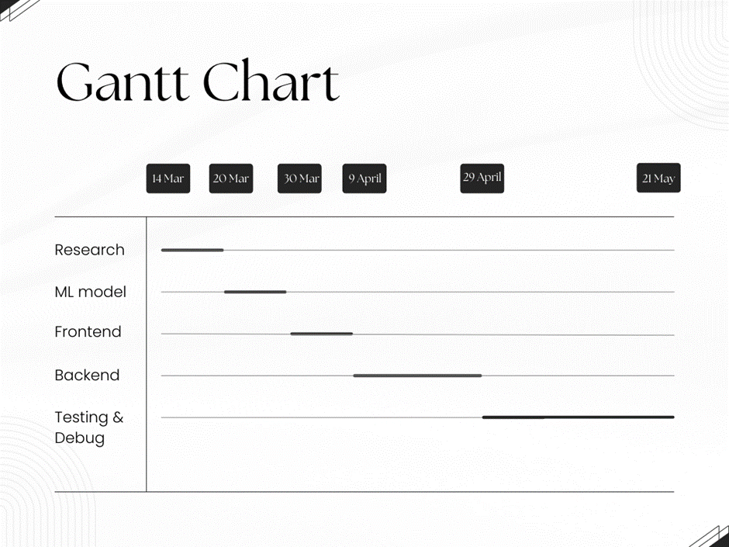
GANTT CHART

Slide 13


